Slide 1
E-commerce Website
Project Title – E-Commerce Website
Name – Shubham Goswami (2115000982)
Rahul Rudra (2115000804)
Samarth Anand Mishra(2115000901)
Aditya Rajput(2215990006)
University Name – GLA University,Mathura
Department Name – Computer Engineering And Applications
Date – 30/11/2023

Slide 2
Introduction
The e-commerce website project is a digital platform designed to streamline online buying and selling, addressing challenges faced by traditional retail and catering to the evolving demands of consumers. With a user-friendly interface, the website ensures easy navigation through product listings, categories, and various sections. It aims to provide businesses with a global reach, transcending geographical limitations and fostering a 24/7 accessible marketplace. By leveraging cost-efficient operations, the platform becomes a more economical avenue for conducting business. To guarantee a secure shopping.
The e-commerce website, now marking its one-year anniversary, has successfully revolutionized the digital marketplace. Its responsive design ensures optimal performance across diverse devices, while personalized user accounts elevate the shopping journey with features like order history and saved preferences. Robust search and filter functionalities empower users to easily discover products tailored to their preferences. Real-time order tracking and notifications enhance transparency, and a responsive customer support system is in place to address inquiries and concerns. This milestone underscores the platform's unwavering commitment to providing a seamless and satisfying online shopping experience.

Slide 3
Objectives
Increase Sales and Revenue: The primary goal is to facilitate online transactions and boost overall sales and revenue for the business.
Enhanced Customer Experience: Provide a user-friendly interface and seamless navigation to ensure a positive and satisfying shopping experience for customers.
Global Market Reach: Extend the business's market reach to a global audience, transcending geographical limitations.
Operational Efficiency: Streamline internal processes such as order management, inventory control, and logistics to enhance overall operational efficiency.
Brand Visibility: Establish a strong online presence to increase brand recognition.
Data Collection and Analysis: Gather and analyze data on customer behavior for informed decision-making.

Slide 4
Problem Statement
The e-commerce website project aims to solve the challenges faced by traditional retail. In regular stores, it's hard to reach many customers, and people nowadays prefer shopping online. So, businesses need to adapt and have a strong online presence. It makes it easier for them to reach more people, provides a better shopping experience for customers, and makes the behind-the-scenes work more efficient. The website also keeps up with what people like to buy online and makes sure that when customers shop, their information stays safe. Essentially, the project helps businesses move into the digital world, meeting what people want today and staying competitive online.
Creating an e-commerce website is essential for businesses to reach a global audience, transcending traditional retail limitations. Online shopping offers customers the flexibility to browse and purchase at any time, ensuring a positive experience. This accessibility significantly boosts sales and revenue. The website adapts to evolving consumer trends, aligning with customer preferences. Streamlining internal processes enhances operational efficiency, and a strong online presence increases brand visibility, crucial for competitiveness in the digital era. The platform's adaptability to changing technology and consumer habits ensures long-term relevance, while secure transactions build trust and valuable data aids informed decision-making.
Creating an e-commerce website is important because it makes shopping super easy for customers. They can shop comfortably from anywhere, anytime. This not only benefits customers but also helps the country's economy grow. So, it's a win easy shopping for people and good for the country's development.

Slide 5
Literature Review
As of now, there haven't been any prior projects or work undertaken in the domain of the current e-commerce website project.
The project aims to bridge a significant gap by providing a seamless shopping experience for people in both urban and rural areas. The focus is on eliminating the disparity between urban and rural areas, allowing people from diverse backgrounds to access the same platform for their shopping needs. Additionally, the project addresses the gap between customers and shopkeepers, fostering a more inclusive and accessible online marketplace.
While there is no specific literature review provided, the identified gap in the current e-commerce landscape emphasizes inclusivity and equal access for both urban and rural populations. Literature in this domain could potentially explore the impact of digital platforms on rural economies, the challenges faced by rural consumers, and the strategies employed to create a more inclusive online shopping experience.

Slide 6
Methodology
Strategic Planning:
Defined goals and identified stakeholders for a detailed project plan.
Aligned project objectives with business needs through strategic planning.
Technology Stack:
Utilized a technology stack of HTML, CSS, and JavaScript for scalable and secure development.
Ensured compatibility and responsiveness using this foundational technology.
Testing and Deployment:
Rigorously tested functionality, performance, and security aspects.
Ensured a smooth deployment process to minimize downtime and transition to the live environment.
Market Research:
Conducted comprehensive market research.
Informed decisions based on market insights.

Slide 7
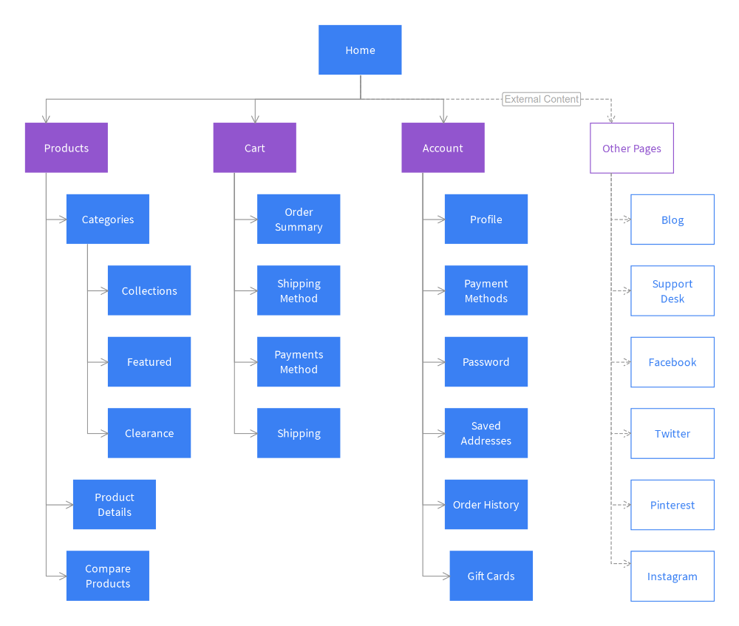
System Architecture

Slide 8
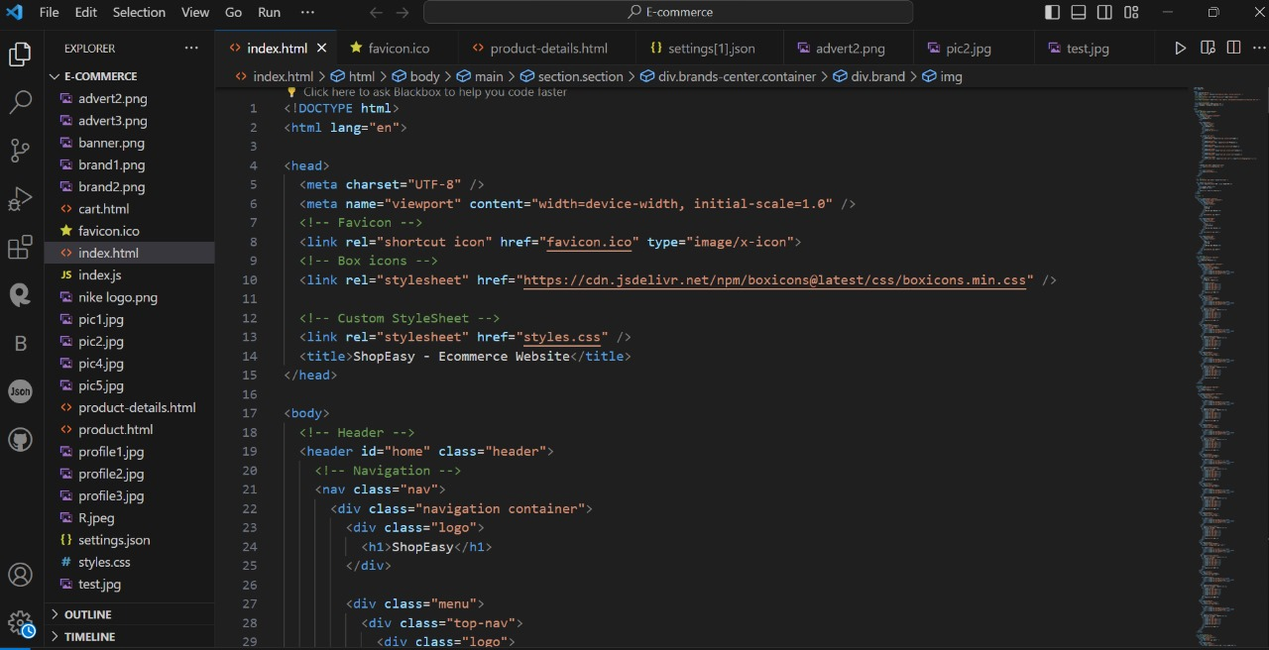
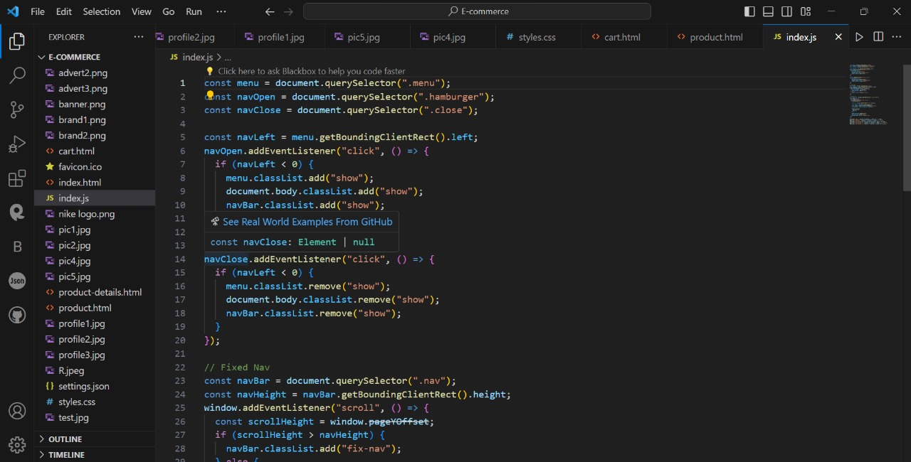
Implementation

Slide 9
Features
User-friendly Interface: Intuitive navigation and a visually appealing design for easy browsing.
Product Catalog: Clearly displayed product information, images, and prices.
Shopping Cart: Implementing a virtual cart for users to add, review, and manage selected items before proceeding to checkout.
Search and Filter Functionality: Providing robust search options and filters to facilitate users in finding specific products efficiently.
Wishlist and Favorites: Allowing users to save products for future reference or purchase.

Slide 10
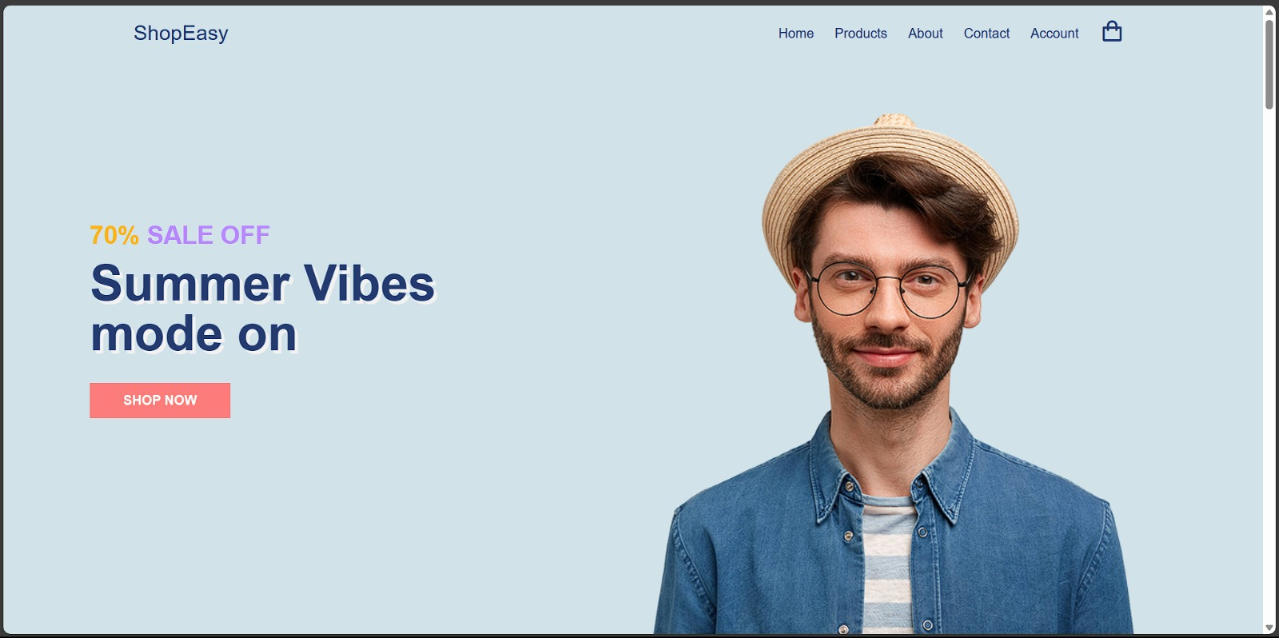
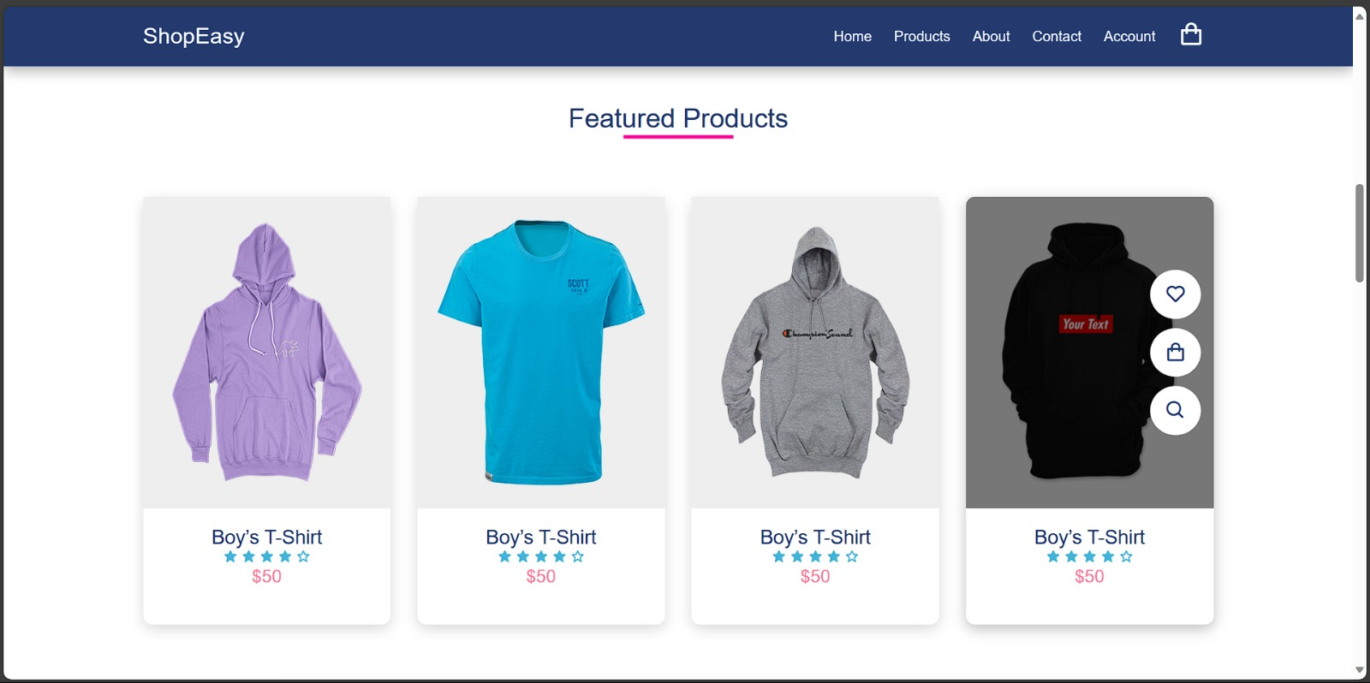
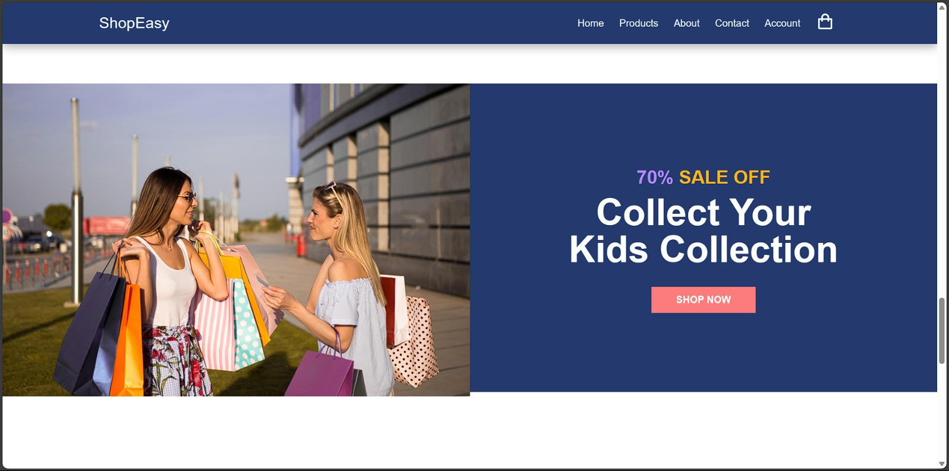
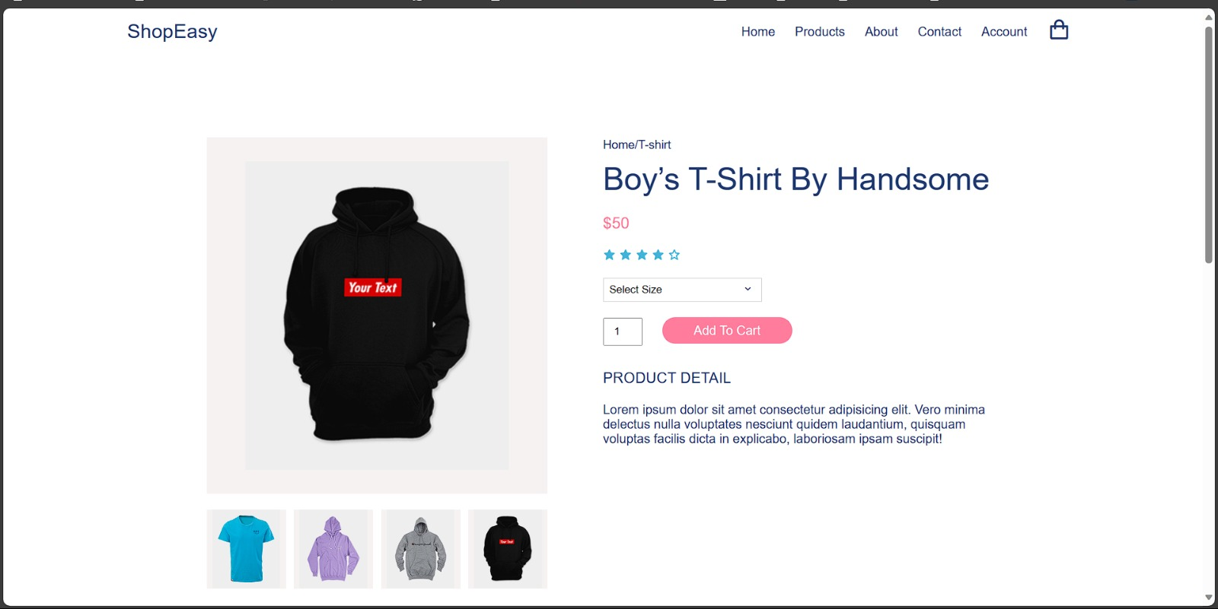
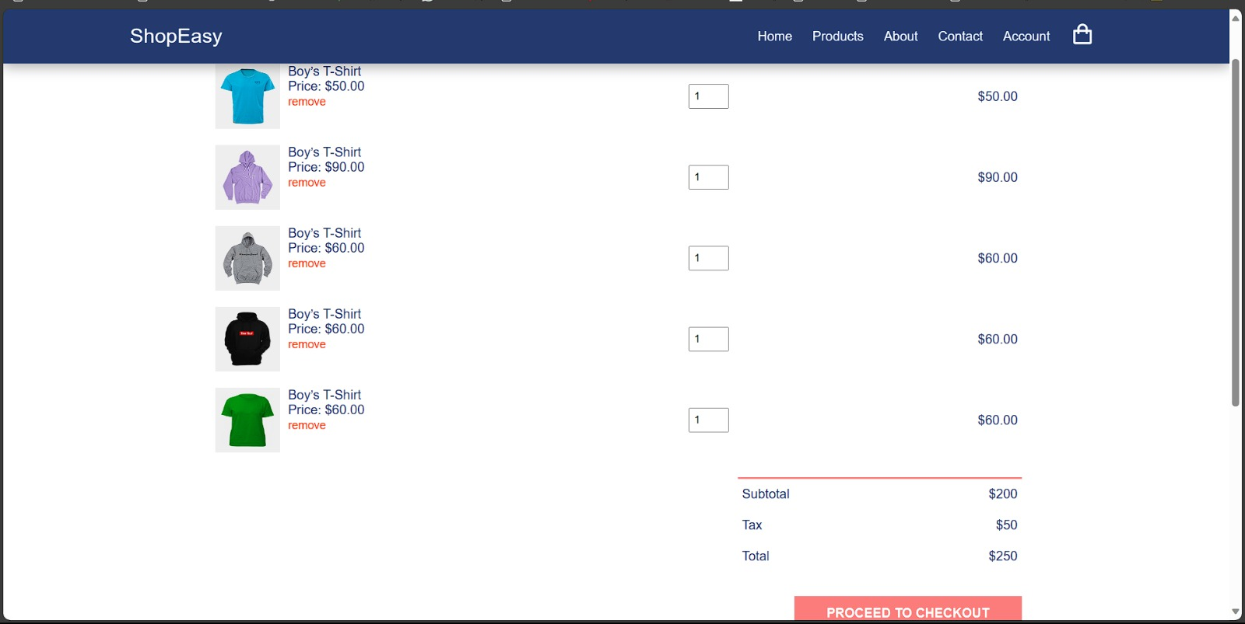
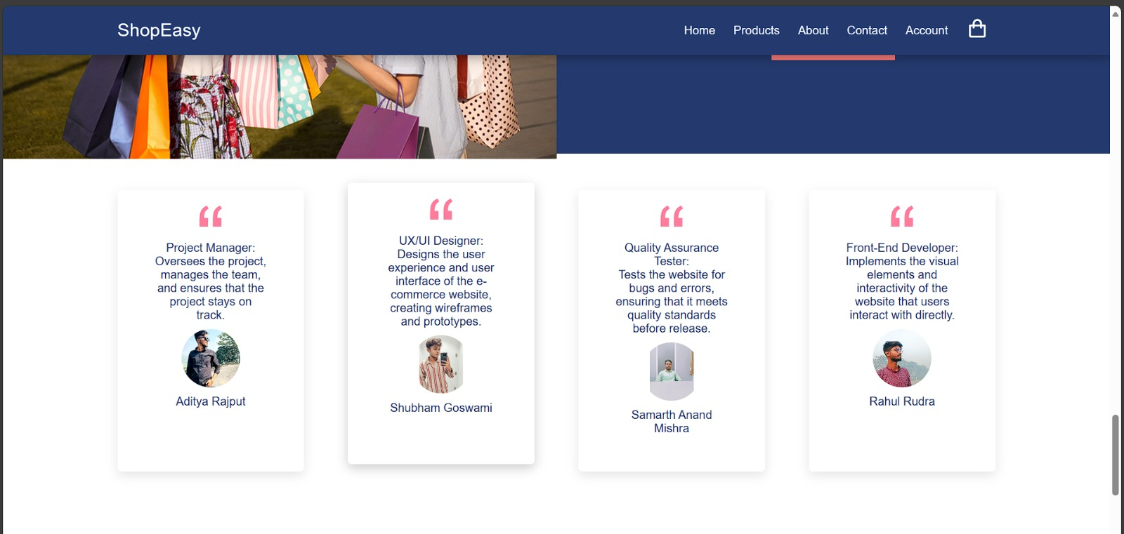
Results

Slide 11
Challenges Faced
Creating the e-commerce website using HTML, CSS, and JavaScript had its challenges. Making sure the payment system was super secure was a big task. We worked closely, following rules to keep user info safe. Figuring out what features users wanted was a bit tricky. We adjusted things based on feedback and what's popular. Teamwork between the folks making the website look good (frontend) and those making it work (backend) was super important. Getting the website to look good and work fast needed lots of changes along the way.
To overcome challenges in building the e-commerce website, we prioritized the security of the payment system by closely collaborating with experts and adhering to industry standards. User feedback played a crucial role in guiding continuous adjustments to align website features with preferences. Effective coordination between frontend and backend teams ensured a seamless user experience. Balancing design appeal and functionality required iterative refinements. Flexibility and adaptability were key, allowing us to embrace changes and adjust strategies as needed. Open communication fostered a collaborative environment, ensuring everyone was on the same page. Through these measures and leveraging HTML, CSS, and JavaScript, we successfully tackled obstacles and delivered a robust e-commerce platform.

Slide 12
Future Work
To enhance and extend the e-commerce website in the future.
Integrate Advanced Technologies
Expand Product Range
Optimize for Voice Search
Enhance User Experience
Incorporate Social Commerce

Slide 13
Conclusion
In conclusion, the development of an e-commerce website is a multifaceted process that requires meticulous planning, strategic decision-making, and seamless collaboration between various teams.
The project initiation phase involves defining clear goals, identifying stakeholders, and creating a detailed project plan. Subsequent weeks focus on market research, technology stack finalization, wireframing, and design implementation.
The frontend development phase emphasizes creating an intuitive and visually appealing user interface, incorporating feedback loops for continuous improvement.
As the project transitions to backend development, testing, and deployment, careful attention is paid to functionality, security, and overall user experience.
Ultimately, the success of the e-commerce website hinges on the ability to meet user needs, adapt to market trends, and deliver a secure and seamless online shopping experience.

Slide 14
Acknowledgments
We would like to express our profound gratitude and deep regard to our mentor Mr. Mandeep Singh for his exemplary guidance, monitoring, and constant encouragement throughout the course of this project. We are profoundly grateful for the unmatched services rendered by him.
I would also like to thank all of the other supporting that was essential and vital, without which I would not have been able to perform efficiency on this project.

Slide 15
Q&A
How does online shopping benefit customers?
How does an e-commerce website contribute to economic growth?
How does online shopping benefit customers?
Is it safe to shop online?

